Slide 1
Midterm Exam
Part 2

Slide 2
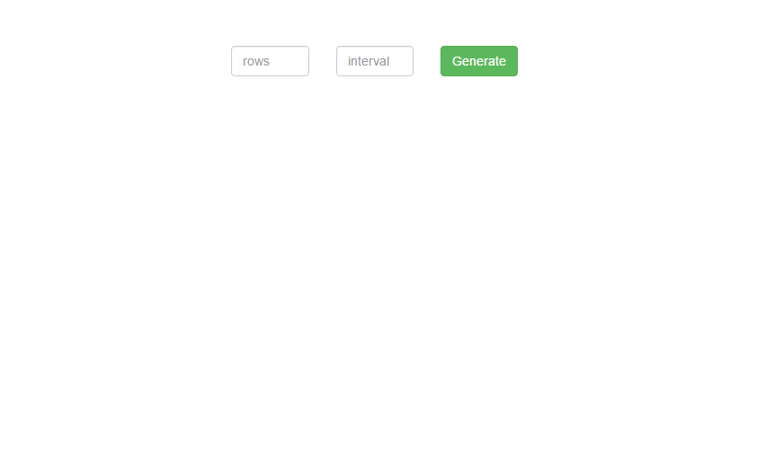
Create a page using bootstrap that has two textboxes and a button.
The button will dynamically create textboxes depending on the number of rows. It will also fill the boxes with data depending on interval.

Slide 3
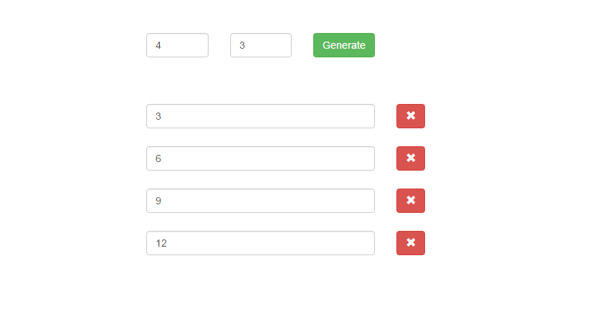
4 Rows – 3 Intervals
Upon clicking on the generate button, using javascript, the browser will add 4 rows of textboxes with accompanying delete row button. Notice that the interval determines the content of the generated textbox

Slide 4
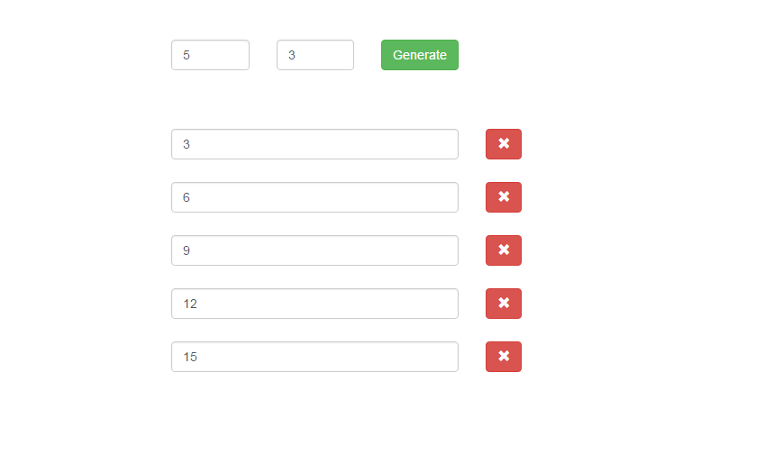
If I change the row box count to a different number, it should be able to adjust accordingly.

Slide 5
If I delete two boxes in the middle…

Slide 6
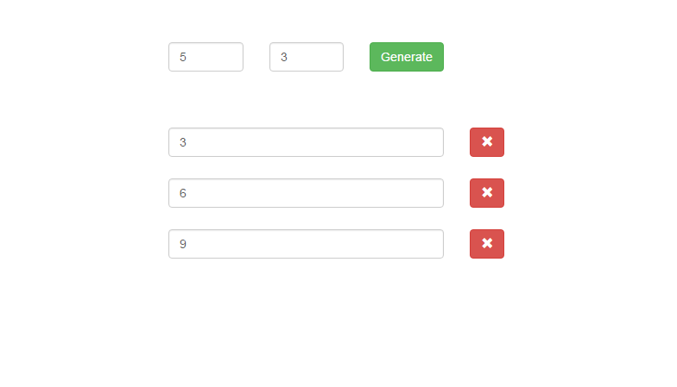
The interval in the textboxes should renumber accordingly.

Slide 7
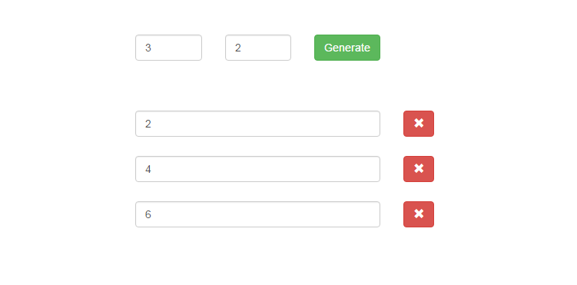
Here’s another example

Slide 8
Notes
Assume that the two input fields will always be given a number.
Elements have to be CREATED. Not hidden/shown. I should be able to generate 5,10 or 1000 rows! As many as the user desires.
Use JQuery functions .each() for looping through objects, .append() to insert additional elements and use .remove() to remove an object from the browser window.
Removing from the end, middle or first should not break the interval counting.

